Slide 1


AI Resilient Assignments
How I learned to stop worrying
and love the process
2026 KCC Faculty In-Service
Megan Baker
Notes:
Handouts: Stoplight with strategies, link to AIAS?, Slides with spot for notes

Slide 2

Introduction: Who am I?
(Insert Jean Valjean joke here)
BA in Biocultural Anthropology
MFA in Visual Arts
Adjunct since 2019
Always willing to talk semiotics or cryptids
What I bring to the conversation:
Focused on learning outcomes, not
technology hype
Committed to practical, accessible,
evidence-based guidance for faculty
Megan Baker
KCC AI Coordinator

Slide 3
Outcomes
Describe how to move from summative (end product) to formative (process) assessment
Compare AI-resilient and non-resilient assignments
Identify at least one change you would like to make to an assignment
Notes:
Mention that all sources and resources for further reading are located on the last slide. Also, note that this is meant to be an introduction – hence the first (maybe second) level Bloom's outcomes. Offer to provide more in-depth resources and talk more about it at a later date if requested.
Plug the AI teaching and learning community on Canvas?

Slide 4

Case Study:
CIS 111
Replacing detection
with design – It's about more than just AI
Notes:
I know I am going to be asking you a lot. So, let's look at a real-world example –

Slide 5
Intro to Video Game
Previous Course Content:
Assessments focused on final product with little feedback.
Unclear rubric/assessment expectations led to student confusion
Unclear alignment between learning outcomes and assessments.
Assignments easily completed by AI
Notes:
Let's start with the why of redesigning the CIS 111: introduction to video games course. The course, as I inherited it, did not have the student outcomes or engagement that I was expecting. Let's look at an example of one of the four parts of the final project.

Slide 6
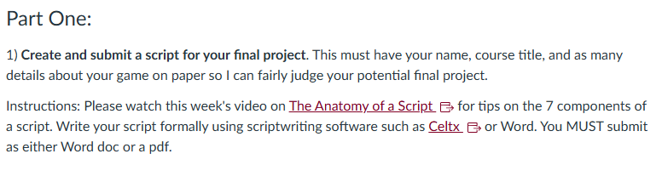
Example – Final Project Part One

Slide 7

How would you revise this assessment

Slide 8
How to use Wooclap

Slide 9
What I Did: Shifting to Process
What was being assessed before?
Does the final game work?
Does it have the certain elements?
What did I actually want to assess (CLOs)?
Fundamentals of Unity software
Programming logic
Systematic and strategic thinking
Creation of game worlds and prefabs

Slide 10
What I Did: Shifting to Process
Weekly check-ins for weeks seven through ten
Required screenshots of progress and short
(50 – 300 word) reflection
Students were able to visually mark progress and articulate learning and challenges
Graded on completion of reflection and progress update, not working prototype – let students experiment with less fear of failure
Allowed for formative feedback and to catch issues early

Slide 11
What I Did: Outcomes and Assessments
Explicitly tied learning outcomes to assessment
Weekly agenda contained learning objects and reason for
their inclusion
Final rubric (Canvas)
Published and available week one
Working final product is only one part of one subsection of
the rubric
Required parts are explicitly listed where needed
Left explanatory comments in each section

Slide 12
What I Did: AI Resilience
Annotated Reading
Theory sections were annotated using Harmonize
Discussion Boards
Students required to post playtest videos/screenshot in discussion boards
Assigned peer reviews
Scaffolded critical analysis assignment early in term

Slide 13
Scaffolding
Final Project
Weeks
7 – 10
Weeks
2 & 3
Week
1
Introduction to game theory
Introduction to final rubric requirements (fill in the blank)
Game Design Document
What is a game quiz
Weekly check-ins
Progress checks & reflections
Game turn in
Brings it all together
Foundational knowledge
Weeks
3 – 6
Weekly labs
Concrete mechanical knowledge

Slide 14

Basic approaches to AI-resilient assignments
"When the light turns green, you go. When the light turns red, you stop. But what do you do when the light turns blue with orange and lavender spots?"
- Shel Silverstein
Notes:
While this training is to help with rethinking assessment, a consequence of that is that your students will have a much clearer understanding of expectations and be much more willing to engage within the parameters you have defined. We are taking something huge and nebulous and turning it into something students can feel comfortable navigating – we are removing the blue with orange and lavender spots.

Slide 15

Controversial Take Incoming
Photo by Andre Hunter on Unsplash
Notes:
Gather your pitch forks and tomatoes. What I am about to say may upset some people. Send small children out of the room, etc, etc

Slide 16
Rethink Everything (Not Really)
The Old Way
The New Way
Rote memorization
Final product based
Punitive
Critical thinking
Process based
Failure required
Notes:
If you truly want to prohibit AI from your courses, you can't keep teaching the way you did 20 years ago. Well you can, but you will drive yourself crazy.
We are going to go more in-depth in the next slides, but if you take one thing away from this training it's this: You will have a much better time and better outcomes if you start to shift your attitude from assessing the product to the process.
That means shifting away from a punitive mindset. I know it is easy to spend time and energy trying to catch cheaters. It feels like a personal insult. I get it. However, it is (I feel) a much better use of time and energy to rethink of why you are assessing what you are assessing and how best to assess it.
Which brings me to

Slide 17

Key Concept
Replace Detection with Design
(AI Assessment Scale 2026)
Photo by UX Indonesia on Unsplash

Slide 18
What does it look like?
Memorization vs. Critical Thinking
Old Way
New Way
Memorize facts but don't necessarily understand them.
Recall answers not question concepts.
Useful for building foundational knowledge.
Easy to circumvent with AI.
Scaffolded learning.
Encourage active, experiential learning.
Slow down assignments.
Notes:
Rote memorization is the fastest way to learn something, period, but without long-term critical thinking and contextual knowledge, rote memorization does not stick and is not a way to get to a goal...unless your goal is to become the next Ken Jennings.

Slide 19

Concrete examples please!
Annotated Reading
(Harmonize – shoutout Jane!)
Commonplacing
Concept maps
Scaffolded assignments
Required reflections
Active learning
Field studies
Collaborative experiential learning
When in doubt, proctor it out!
Photo by uve sanchez on Unsplash
Notes:
Okay, mushy stuff done. Let's talk how you realistically do this:
Annotating: You may point out to students that they can offer glosses, provide interpretations, ask or respond to questions, and offer personal responses in their annotations, as appropriate.
Commonplacing: Have students record quotes, notes, passages, etc. In microsoft onenote (Ms365 LTI)
Concept maps: tudents can create diagrams that show the relationships between ideas, with connecting lines and linking words visually and textually describing the relationships between concepts.
Scaffolded assignments: Break up large assignments or problems into smaller assignment. Research papers into smaller assignments: exploratory writing, drafting, annotated bibliography, etc. Also, teamwork scaffolded assignments – break up problems into smaller steps and have each person in the group solve one piece before passing to the next.
Required reflections: have students explain why they chose the refrences, topic, source material, etc for their projects. Have them explain lessons learned, including what didn't work and what they learned from it. Talk about how the concept relates to their personal experiences.
Active learning: use kahoot for interactivity during lectures, real time knowledge check ins. Use Panopto for video quizzes and knowledge checks during video lectures.
Collaborative experiential learning: have students tackle a real-world issue. Let them think outside the box. Give example of anatomy and physiology students building skeletal maps out of food, coloring books, etc.

Slide 20
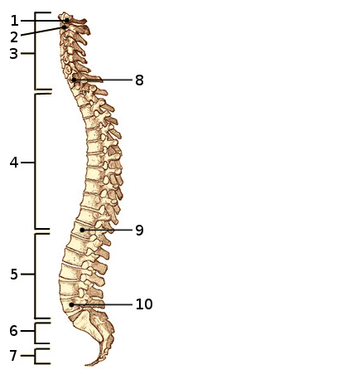
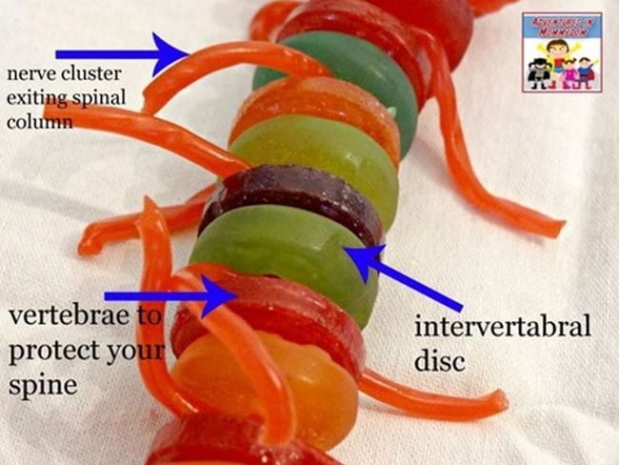
Example: AI- Resilient Active Learning for Anatomy
Old
New

Slide 21

Examples for each on the
AI Teaching and Learning Community

Slide 22

Thought Exercise
(5-minute reflection, 10-minute share)
Imagine you are talking to a colleague who teaches math. They've noticed their students do well on your homework assignments but bomb proctored tests. Their current homework assignments are problem sets where students turn in a final answer.
Think on and discuss the following:
How susceptible are their current assignments to AI?
What are they assessing? What do they want to assess?
What changes would you suggest to their current assessment strategies?
How might these changes affect grading practices?
Photo by Bhautik Patel on Unsplash
Notes:
Time for an interactive exercise. Explain the exercise. Put on some gentle lo-fi and start a timer.

Slide 23

Key Concept
There is no growth without discomfort
Photo by Sushobhan Badhai on Unsplash
Notes:
Once we move away from product-based assessment, students learn that it is okay to try and fail. With the barrier of failure lowered, students are less likely to reach to the 'easy way' of genAI tools. When they can see their progress in a very real way, they are more likely to engage and grow. Finally, when students understand the why of what they are learning they are willing to put in the effort of deep-learning.
Putting on my rose-colored glasses - when you are teaching math, you aren't just teaching addition, you are teaching a student how to understand proration on their bills or how to get a good loan rate or how to pay their taxes. Essay writing teaches students how to structure compelling arguments, find credible sources, and spot logical fallacies. On the surface you may be assessing certain skills, but deeper you are teaching students how to be a functioning member of society.

Slide 24
Final Activity
(10-minute reflection, 15-minute small group discussion)
Choose one existing assignment you would like
to change:
What is it assessing currently? What do you want it to assess?
What steps are important for you to assess?
What will have to change?
Photo by Bhautik Patel on Unsplash
Notes:
More lo-fi and timer. Make sure to wander the room and see how the discussion is going.

Slide 25

What do I do now?
t
Want help brainstorming or redesigning an assignment –
Contact the CTL via a support ticket: Ctlsupport@klamathcc.edu
We would be happy to meet with you!
t
Want a more DIY approach?
Use the AI Assessment Scale (AIAS)
AIAssessmentScale.com
as a starting point.
AIAS features a custom GPT to walk you through assignment redesign
t
Don't forget to join the Canvas AI Teaching and Learning Community!
Notes:
Closing – time for questions and wrap up

Slide 26
Sources and further reading
Sources
  Acar, et al (2025, August 1). Research: The Hidden Penalty of Using AI at Work. Harvard Business Review. https://hbr.org/2025/08/research-the-hidden-penalty-of-using-ai-at-work
  AI Meets Education at Stanford (AIMES). (2025, September 22). AI teaching strategies. Stanford Center for Teaching and Learning. https://ctl.stanford.edu/aimes/ai-teaching-strategies#ai-prohibited
  Learning Innovation Practice Ltd. (2026, July 27). Implementation guide. The AI Assessment Scale. https://aiassessmentscale.com/implementation-guide/
  Silverstein, Shel. "Signals." A Light in the Attic, Harper & Row, 1981, p. 147.
  University of Chicago. (n.d.). Strategies for designing AI-resistant assignments. University of Chicago IT Services. https://genai.uchicago.edu/resources/faculty-and-instructors/strategies-for-designing-ai-resistant-assignments
Further Reading
  AI Pedagogy Project (N.D.). Assignments. https://Aipedagogy.org/assignments/
  Perkins, Furze, Roe & MacVaugh (2024). The Al Assessment Scale. https://aiassessmentscale.com/ (includes several peer-reviewed publications using
  the scale)

